Slide 1
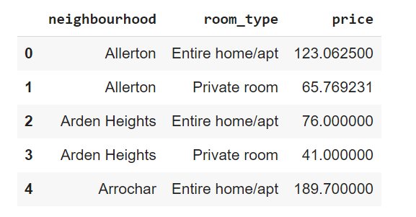
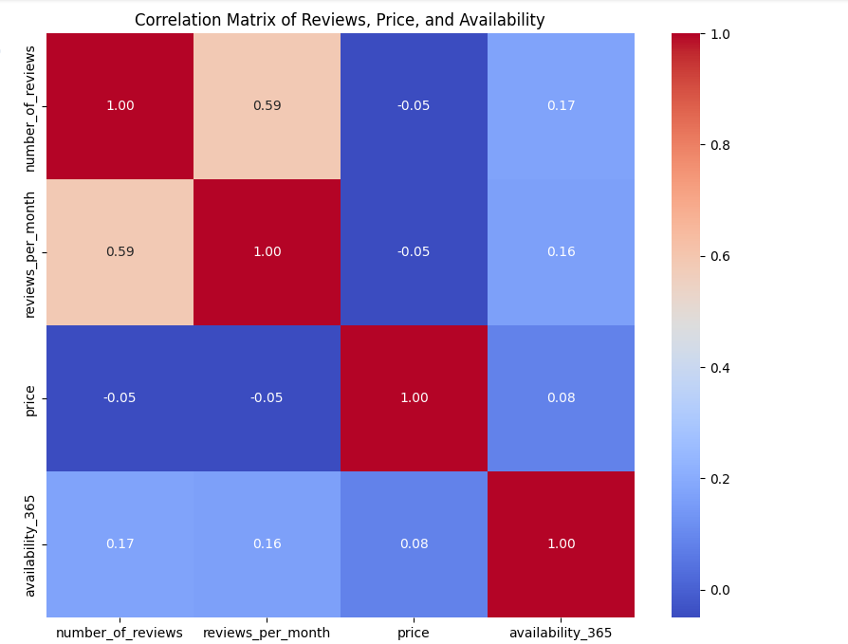
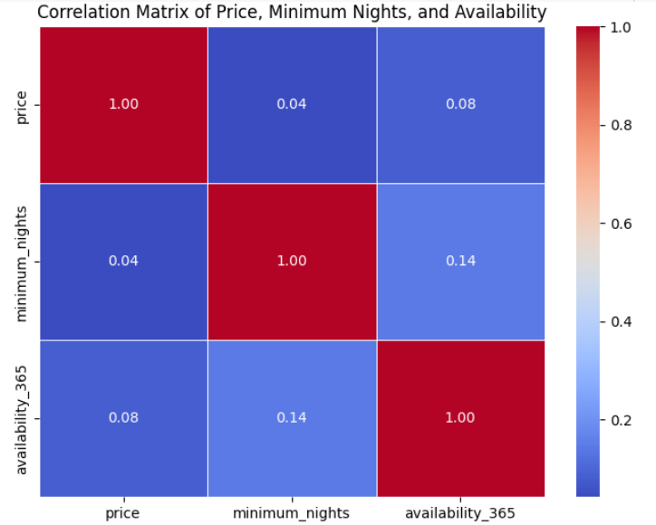
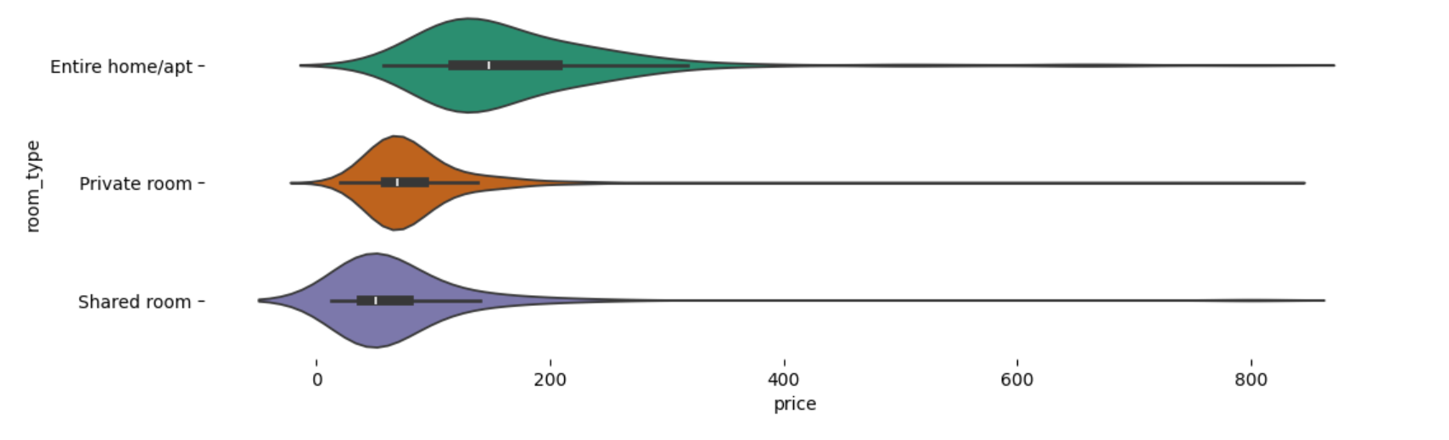
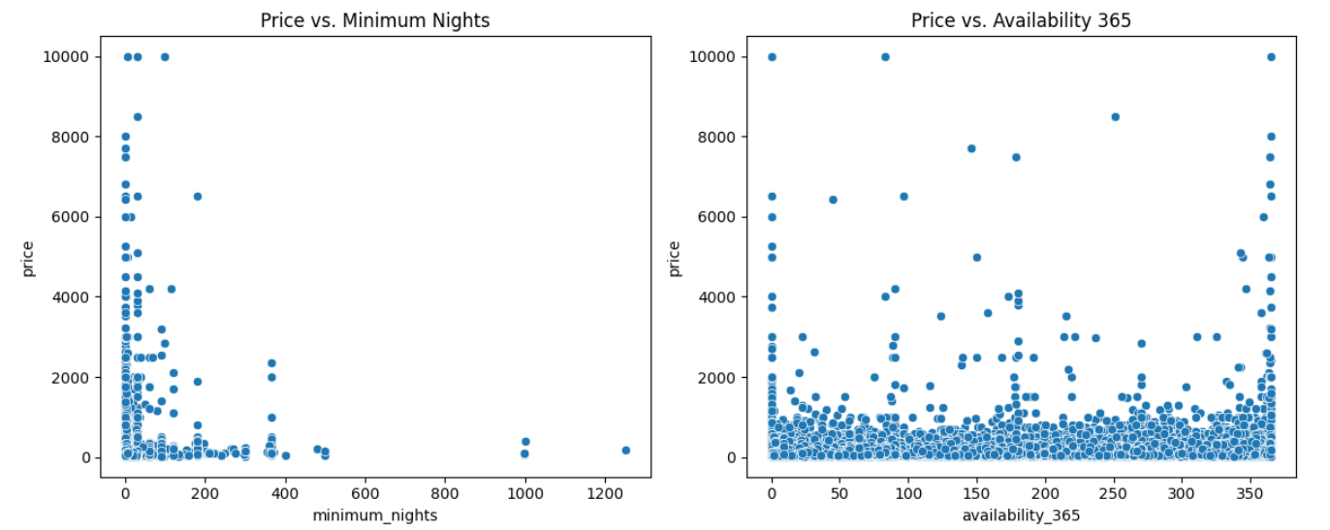
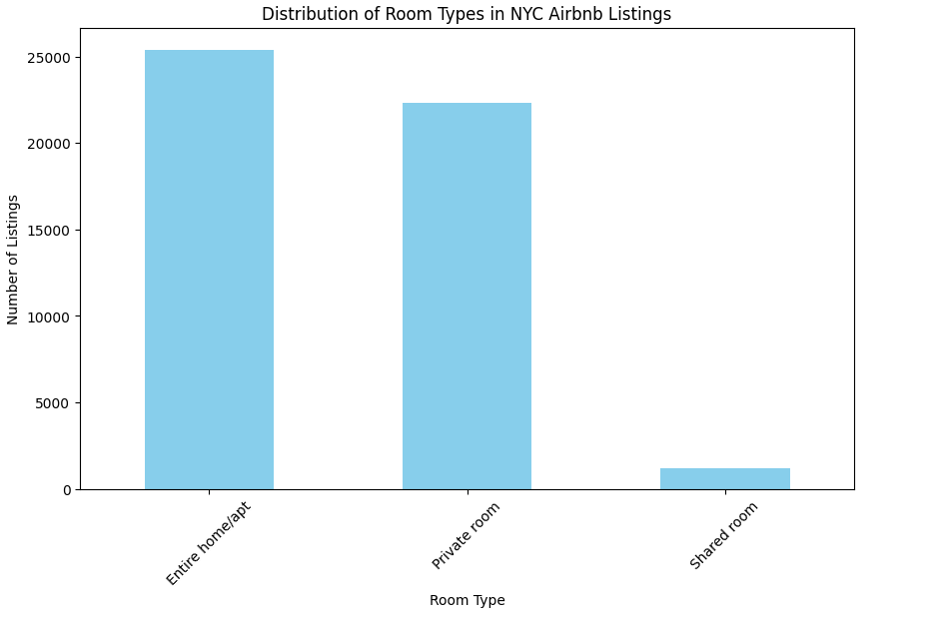
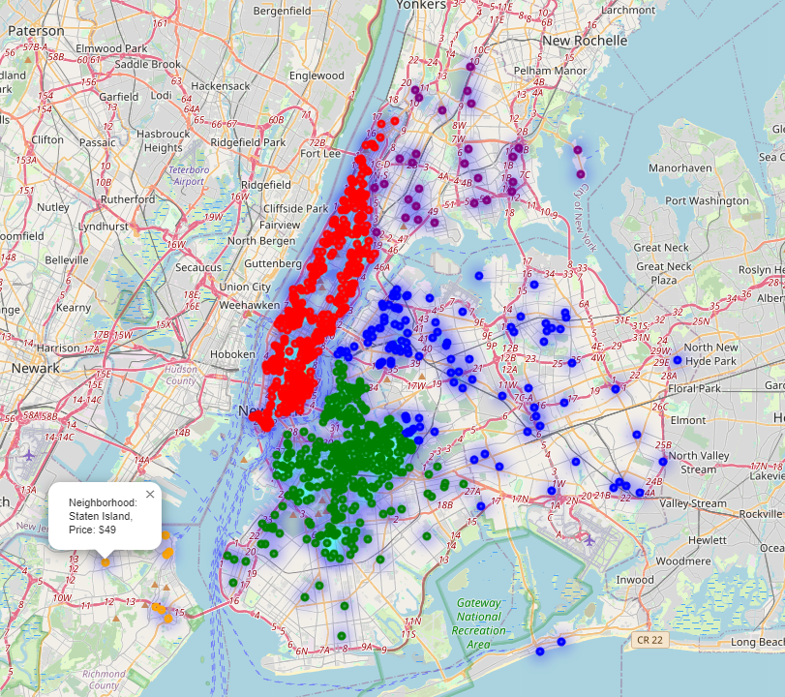
AIR-BNB NYC 2019 – Insights
IST 652 – Scripting for Data Analysis
Tanvi Pradhan, Priya Vora & Keshav Ch
This project explores the dynamic world of short-term rental properties in New York City using the "AIRBNB_NYC_2019" dataset, which includes nearly 49,000 listings. The focus is on providing actionable insights for hosts, policymakers, and potential renters regarding pricing strategies, occupancy rates, and the influence of reviews on rental attractiveness.
Data Cleaning: Handled missing values, removed outliers, and corrected data inconsistencies.
Data Transformation: Applied one-hot encoding to categorical data, converted dates to datetime format, and normalized the price variable by replacing zeros with the mean price.
The dataset includes variables like listing ID, host ID, neighborhood, room type, price, minimum nights, number of reviews, last review, reviews per month, and availability for 365 days. This provides a comprehensive view of the short-term rental landscape in NYC.
Introduction
Methodology
Characteristics of data
Research Q1 : How does the average price vary across different neighborhoods and room types?
Research Q2 : How do reviews and their frequency influence a listing’s price and occupancy rates?
Research Q5 : How do the number of minimum nights and listing availability correlate with pricing strategies?
.
Research Q4: What is the distribution and popularity of different room types among Airbnb listings?
Research Q3 : What are the patterns in the spatial distribution of Airbnb listings across NYC’s neighborhoods?
Wide price variations by neighborhood and accommodation type.
Higher listing concentrations in certain areas.
Positive, frequent reviews boost prices and demand.
Predominance of entire homes/apartments; private rooms also popular.
Regulation influences on pricing via minimum stays and availability.
Conclusion

